Slide 1
Risk Management Plan & EVA
IT463 - Group 3
Grad Bird Consultants
Eric Agyemang
Anitha Kona
Pranavi Konda
Daniel Freburg

Slide 2
Project Description
The City of Mequon provides public and information services to the citizens that enhance the quality of life in the community.
The original project was for 3- 5 years strategic plan which was changed to focus on 3-4 year IT infrastructure plan.
The project now includes an IT Security consultant which will enhance the security feature of the project.
Project schedule and budget has reduced.
The project now includes risk assessment and EVA.

Slide 3
Measurable Organizational Value (MOV)
Plan includes incremental cost-effective changes during the next 4 years.
Plan increases IT security by migrating backup data to AWS and including a Security Software Company
Plan increases networks speeds by upgrading current Wi-Fi routers to the newest and most powerful NetGear Wi-Fi routers. (3.6 Gbps combined throughput)
Ensure wired network reliability, 2 network switches will be replaced per year
Workstation desktops and laptops will be incrementally replaced
Ensure system reliability and accessibility, 3 servers will be replaced
The purpose of these cost-effective upgrades is to provide a highly beneficial system so that the city can continue to provide cost-effective services to the citizens of Mequon.

Slide 4
MOV
​ Organizational Impact ​ ​ ​ | Value ​ | Metric ​ | Time Frame ​
Customer | Provide a better IT System to the city so the citizens can continue having low-cost services | Fewer complaints from citizens. 10% reduction (current count- 200 complaints estimated) Improving citizen satisfaction with website access and interaction (increased annual survey satisfaction numbers) | Annual Survey Annual Survey

Slide 5
MOV
​ Organizational Impact ​ ​ ​ | Value ​ | Metric ​ | Time Frame ​
Financial | Effectively spending the city resources to improve or maintain the current IT system | Within Budget $88,000 And possible savings of 10% | Annual Budget

Slide 6
MOV
​ Organizational Impact ​ ​ ​ | Value ​ | Metric ​ | Time Frame ​
Operational | A more efficient IT system that is more available, reliable, secure and faster. | Reduced downtimes by 10%, improved performance (2x faster), higher usability (increase in citizen usage by 10% and increased staff satisfaction), better security (AWS guarantees 100% security) | Annual Survey

Slide 7
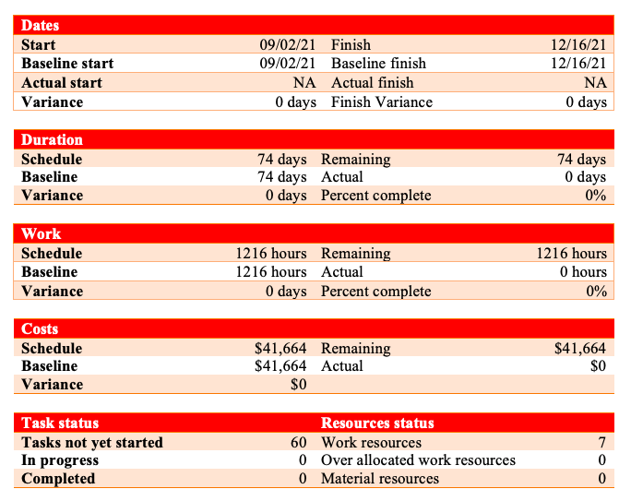
...
Baseline Project Summary

Slide 8
Baseline Budget
 | Year 1 | Year 2 | Year 3 | Year 4
Funds | $110,000 | $110,000 | $110,000 | $110,000
Project Team Salaries | ($39,200) | ($39,200) | ($39,200) | ($39,200)
IT Dept Salaries | ($4,240) | ($4,240) | ($4,240) | ($4,240)
Office supplies | ($1,800) | ($1,800) | ($1,800) | ($1,800)
Proposed Plan | ($32,711) | ($32,711) | ($32,711) | ($32,711)
Contingency | ($10,000) | ($10,000) | ($10,000) | ($10,000)
Total Surplus | $22,049 | $22,049 | $22,049 | $22,049

Slide 9
Risk Analysis And Planal
RISK | RISK DESCRIPTION | STRATEGY DESCRIPTION | OWNER
PHASE 1: Project Initialization Changed MOV | If the project sponsor changes the MOV and the MOV becomes unclear, the project's entire conceptualization might have to be changed. It is unknown-known. The source is internal and emerges from people (the project sponsor) | Having timely meetings with the stakeholder to discuss any possible changes. Will allow our team to have the time to reconceptualize the project. Our team will be in an agile mode to adjust to unanticipated changes. | Project Manager

Slide 10
Risk Analysis And Planal
RISK | RISK DESCRIPTION | STRATEGY DESCRIPTION | OWNER
PHASE 2: Project charter and Scope Management plan Changed Scope | If the project sponsor widens or narrows the scope during the project charter and scope management phase, the scope management plan will have to be adjusted. It is unknown-known. The source is internal and emerges from people (the project sponsor) | Having timely meetings with the stakeholder to discuss any possible changes will allow our team to have time to manage changes. | Project Manager

Slide 11
Risk Analysis And Planal
RISK | RISK DESCRIPTION | STRATEGY DESCRIPTION | OWNER
PHASE 3: Project Execution and control Changed Budget | If the project sponsor changes the budget our team will modify the project plan accordingly. If the budget is reduced, the project team will decrease the scope and time. If it is increased, the scope and time will be increased accordingly. It is unknown-known. The source is internal and emerges from people (the project sponsor) | The project team will incorporate a buffer within the budget to mitigate decreases. The team will widen the scope accordingly when budget increases. | Project Manager, Project Team

Slide 12
Risk Analysis And Planal
RISK | RISK DESCRIPTION | STRATEGY DESCRIPTION | OWNER
PHASE 4: Close project Failure to Meet Schedule | If the project team fails to meet schedule the closure milestone might be delayed in completion. This may lead to a delay in the subsequent phases. It is known-unknown. The source is internal/external and emerges from people, organizational, process and technology. | The team will schedule plans carefully with slacks and prioritize maintaining the schedule. | Project Team and Stakeholder

Slide 13
Risk Analysis And Planal
RISK | RISK DESCRIPTION | STRATEGY DESCRIPTION | OWNER
PHASE 5: Evaluating the Project Success Survey Process Failures | Our project evaluation is dependent on the successful survey process. Delayed surveys and inaccurate responses will adversely affect the evaluated results. It is known -known. The source is internal /external and it emerges from people, and process. | The project team will send follow up emails for clarification on responses and notifications to non-responses. These will ensure more accurate responses and a better evaluation. | Project Team

Slide 14
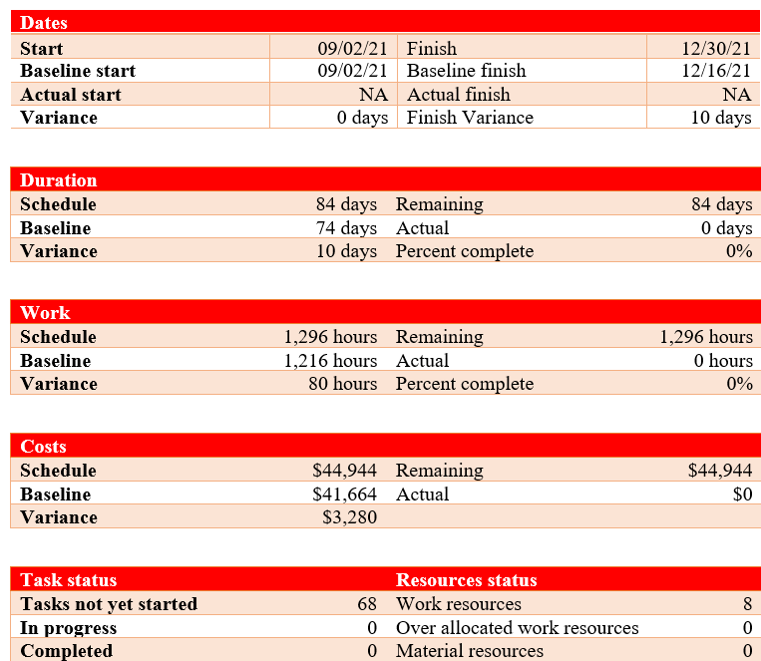
...
Revised Project Summary

Slide 15
...RRRREEER
Revised Budget
 | Year 1 | Year 2 | Year 3 | Year 4
Funds | $88,000 | $88,000 | $88,000 | $88,000
Project Team Salaries | ($39,200) | ($39,200) | ($39,200) | ($39,200)
IT DEPT SALARIES | ($4,240) | ($4,240) | ($4,240) | ($4,240)
IT Security Consultant | ($3,936) | ($3,936) | ($3,936) | ($3,936)
Office supplies | ($1,800) | ($1,800) | ($1,800) | ($1,800)
Proposed Plan | ($32,711) | ($32,711) | ($32,711) | ($32,711)
Contingency | ($10,000) | ($10,000) | ($10,000) | ($10,000)
Total Deficit | (3,887) | (3,887) | (3,887) | (3,887)

Slide 16
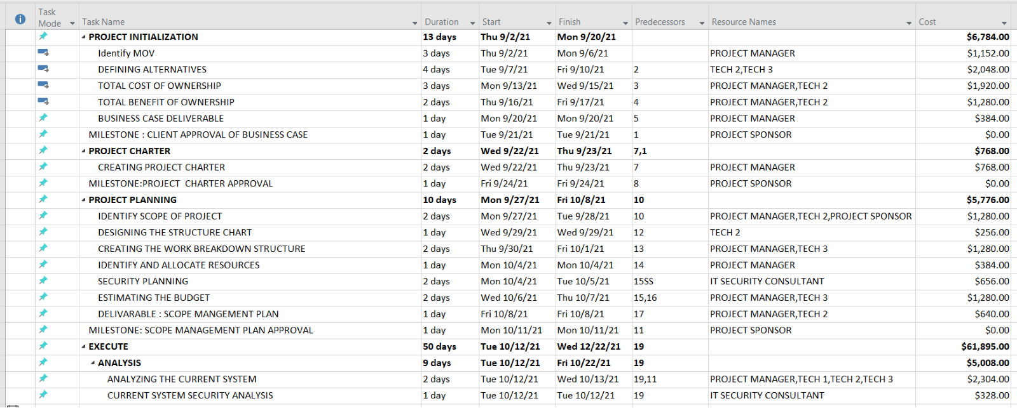
...
Revised WBS

Slide 17
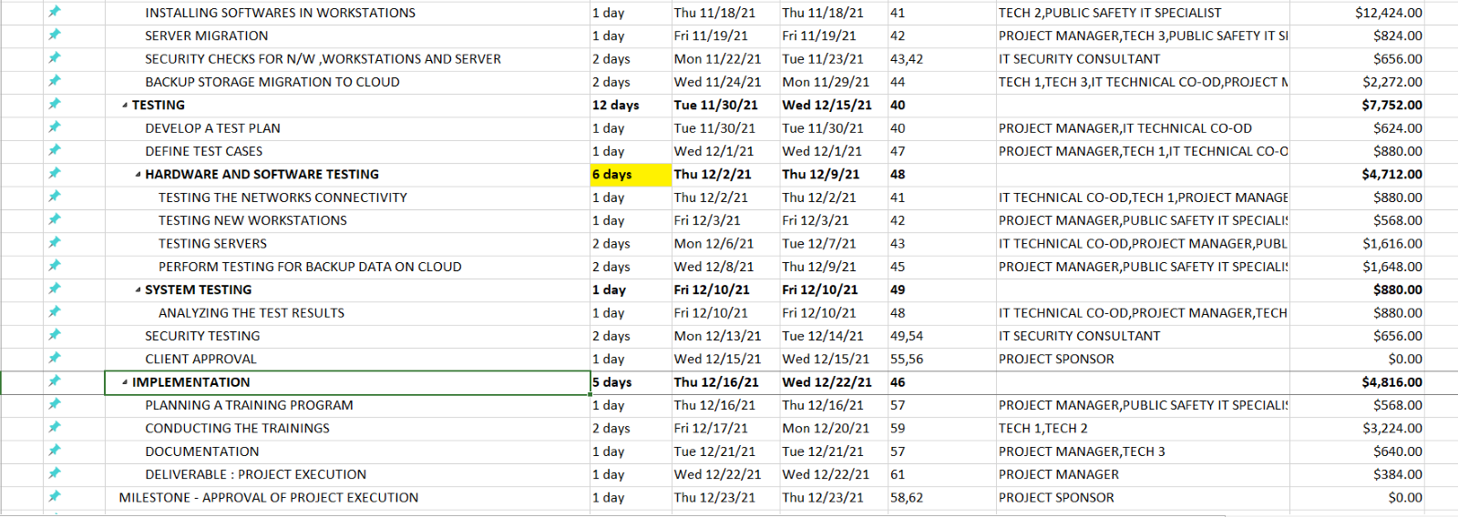
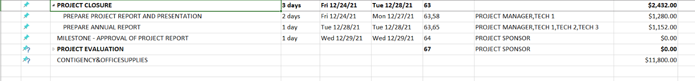
...
Revised WBS

Slide 18
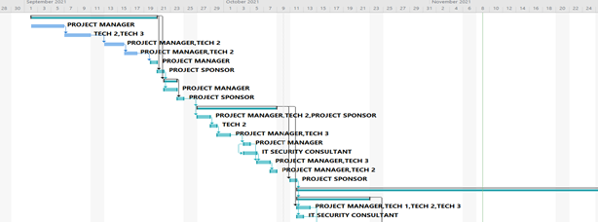
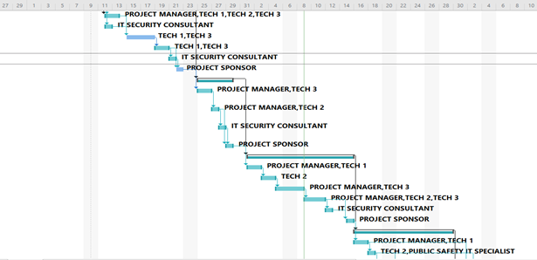
Revised Gantt Chart

Slide 19
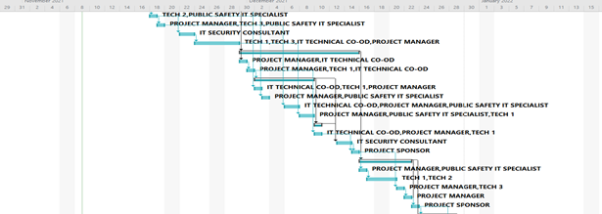
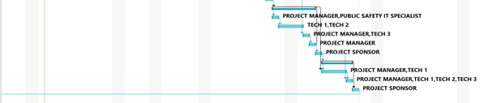
Revised Gantt Chart

Slide 20
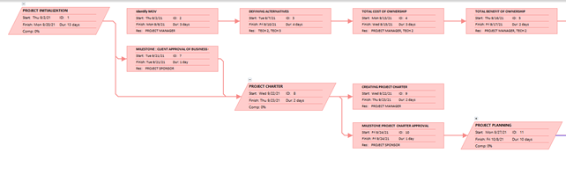
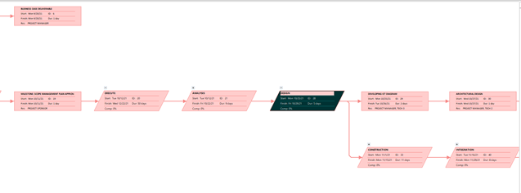
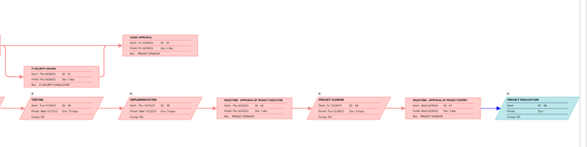
Revised Critical Path

Slide 21
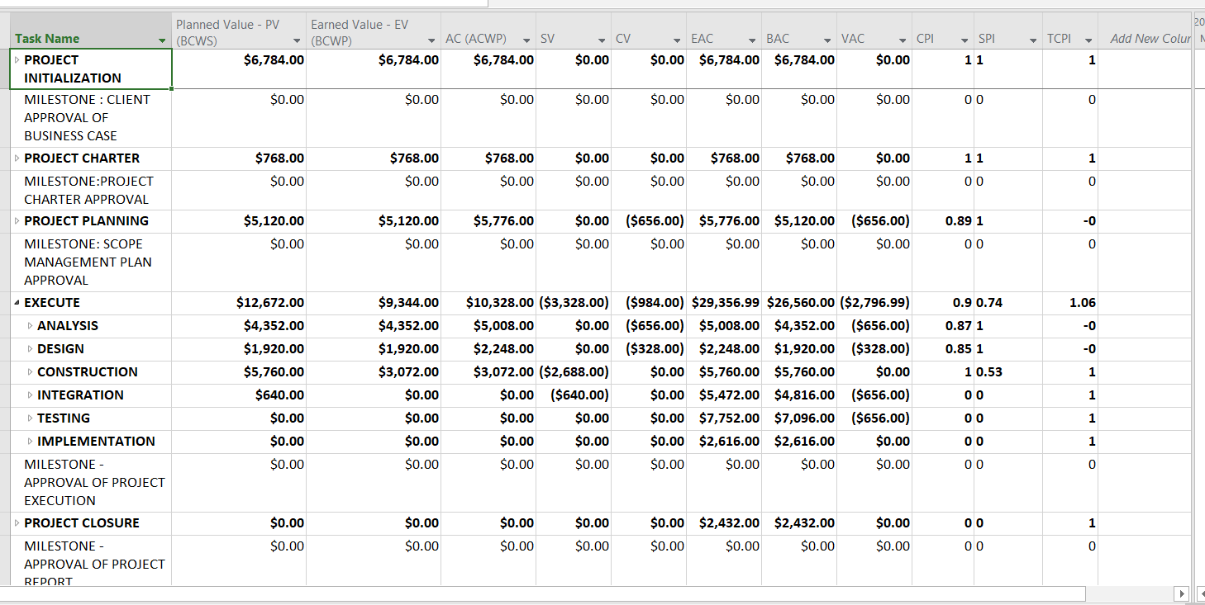
EVR

Slide 22
EVR
IT Security Consultant added as follows:
- Planning – 2 days ( 20%) - Analysis – 2 days (20%)
- Design – 1 day (10%) - Construction – 1 day (10 %)
- Integration – 2 days (20%) - Testing – 2 days (20%)
Indicators
SV value is negative indicates project is behind schedule
EAC value $45,116.99 (till 11/9/21) which is the estimated amount to complete the project if we believe the variance encountered so far will not continue through the remaining project schedule
TCPI value is 1.06 which indicates the project will be difficult to complete on time and within
budget.
- From our assessment of the TCPI, the original budget/time at completion is not reasonable.

Slide 23
Proposed Solution
The WBS was reduced by 20 days because tasks were parallelized, personal were rescheduled and reassigned to reduce cost and schedule
The new end date is Dec 2 which bring the project back on track
The 20-day reduction reduced salary costs by $5,986
Laptop replacements will be changed from the Dell 5400 to a cheaper HP 15-dy2089ys 15.6 costing $650 which will save $659 per laptop. The annual saving on the change of workstation laptops will be $3,295 annually.
The workstation desktops will also be replaced from the Dell HP G2 Tower Z5 to a cheaper HP 24-dp0158qe AiO PC costing $800 which will save us $474 per desktop workstation. The annual savings on that change will be $2,370.
These changes meet the Stakeholders requests and increase IT security aspects.
Proposed solution creates a $12,764 surplus which exceeds the MOV metric of 10% below budget

Slide 24
Source Links
Resource | Cost | Source
Project Manager | $48 per hour | https://www.zippia.com/software-project-manager-jobs/salary/
Tech Team (Tech 1, Tech 2 , Tech 3) | $32 per hour | https://www.salary.com/research/salary/recruiting/tech-analyst-hourly-wages
IT Co-Ordinator | $30 per hour | https://www.zippia.com/technology-coordinator-jobs/salary/
Public Safety IT Specialist | $23 per hour | https://www.governmentjobs.com/jobs/3256500-0/public-safety-specialist-ft
IT Security Consultant | $41 per hour | https://www.payscale.com/research/US/Job=Information_Technology_(IT)_Consultant/Salary
Workstation HP 24 – DP0158QE AiO PC | $800 per workstation | https://www.hp.com/us-en/shop/pdp/hp-all-in-one-24-dp0158qe
Laptops | $650 per laptop | https://www.microsoft.com/en-us/d/hp-15-dy2089ms-156-laptop/8qkt9whdj64x?activetab=pivot:techspecstab

Slide 25
Thank You

